Slide 1
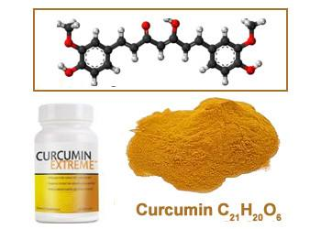
Turmeric
Curcumin
3
姜黄素的加工工艺
4
产品功效及机理

Slide 2
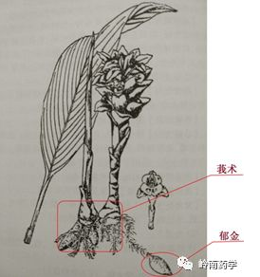
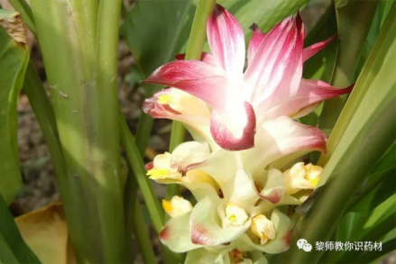
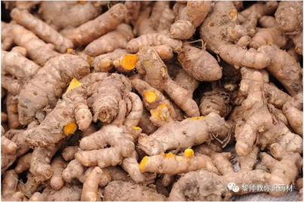
The plant source of curcumin
01
1. Turmeric ： The dried rhizome of Curcuma Longa L.
2. Place of origin
The dry roots of curcuma are best harvested in winter from late January to late February,
Szechwan province is the origin of best turmeric medicinal usage.

Slide 3
Analysis of turmeric from different origin
So best origin of curcumin is Szechwan and we only use the excellent material from Szechwan.
Notes:
川药：江油的附子、绵阳的麦冬、灌县的川穹、石柱的黄连、遂宁的白芷等；云药比如文山三七；槟榔、砂仁、巴戟天、益智仁是我国著名的“四大南药

Slide 4
02
The ingredient of curcumin
4.1 Chemical composition
Curcumin contains a variety of chemical components, : Curcumin, Bisdemethoxycurcumin, normocurcumin, Dihydrocurcumin.In addition, it also contains sesquiterpene compounds: curcumone, curcumanol A, B and other components.

Slide 5
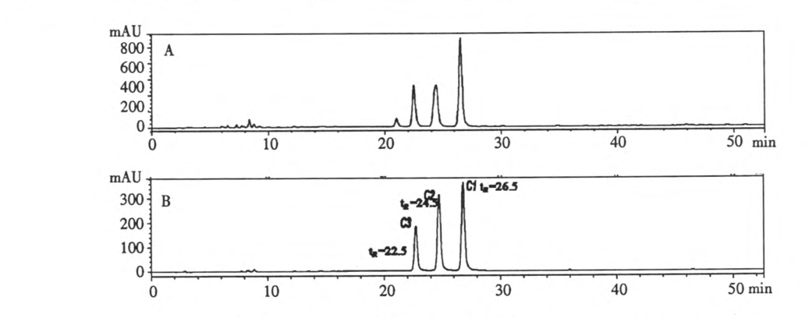
4.2 HPLC chromatography of turmeric
C1 Curcumin C2 Demethoxycurcumin C3 Double demethoxycurcumin

Slide 6
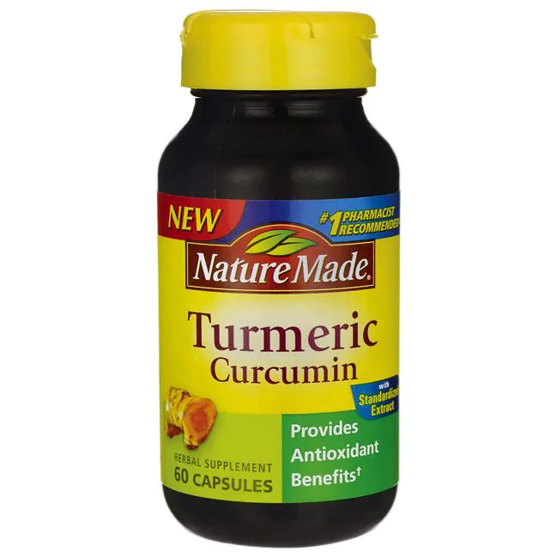
03
Efficacy and application
protect liver
Antioxidation
1
2
turmeric anti-inflammatory
Antineoplastic
3
4

Slide 7
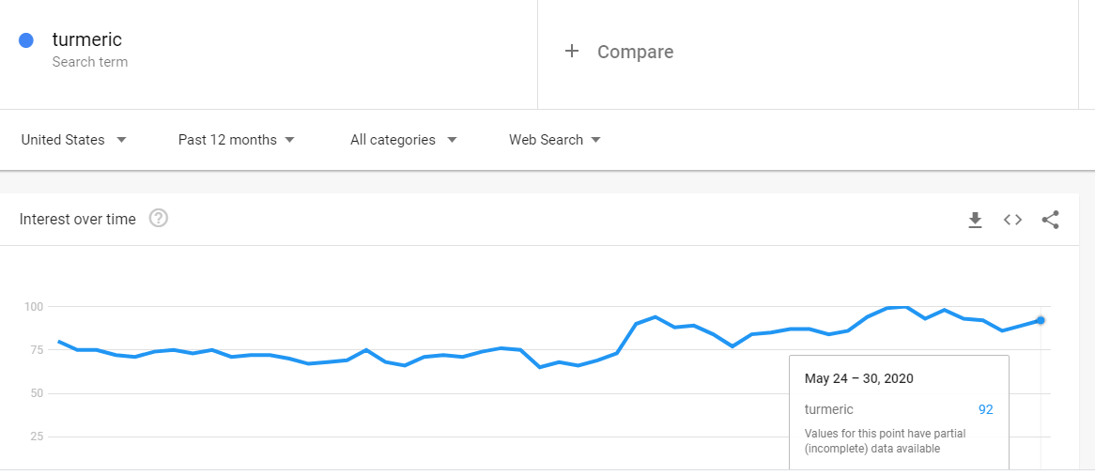
Google trend of the past 12 months

Slide 8
Turmeric
2.1 抑制胶原合成
2.2 激活过氧化物酶体增殖体活化受体活性
Turmeric is commonly used for conditions involving pain and inflammation, such as osteoarthritis. It is also used for hay fever, depression, high cholesterol, a type of liver disease, and itching. As a natural raw material, there is greater potential for human health.

Slide 9
Thank you
AVANHERB BIOTECH CO.,LTD.
Tracy li,Vice Manager
E-mail: tracyli@avanherb.com
Tel:0086-29-85725646
Fax:0086-29-85725648
Mob:0086-18681879537

